Slide 1
USCIS H-1B ONLINE REGISTRATION FOR REGISTRANTS
02/06/2020
Notes:
With a USCIS online account, you can file certain applications and petitions online and track their status.
Prospective petitioners seeking to file H-1B cap-subject petitions, including those filing for beneficiaries eligible for the advanced degree exemption, must first electronically register with USCIS.
Submitting an H-1B registration requires one of two types of USCIS online accounts. The appropriate type depends on the submitter’s role:
Representatives will use the same type of representative account that is already available and may use an existing account. Creating and using this type of account is the subject of our webinar on Feb. 11.
Prospective petitioners submitting their own registrations (U.S. employers and U.S. agents, collectively known as “registrants”) will use a new “registrant” account that will be available beginning Feb. 24.
There is a $10 H-1B fee to register each beneficiary for the H-1B selection process. However, the USCIS online account itself is free.
During today’s presentation, we will show you how to create a registrant account, how to submit an electronic H-1B registration on behalf of beneficiaries, and how to pay the fee for each registration submitted, whether separately or in a batch.
When filing online, you can be sure that:
You filled out all the required parts of the registration;
You will receive an online confirmation once USCIS receives your registration.
You will also be able to:
Receive automatic updates concerning your registration; and
Conveniently and securely pay registration fees online.

Slide 2
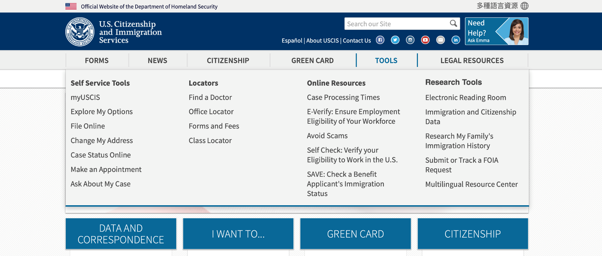
NAVIGATING TO myUSCIS
Notes:
Navigating to myUSCIS – slide 2
You can find all of our online tools and resources on uscis.gov by clicking on or hovering over the Tools button. Go to myUSCIS to access the USCIS online account by clicking myUSCIS under Self Service Tools on the left.
We continue to improve the experience and design, so please don’t be alarmed if in the coming weeks and months you notice some tweaks to what you see today. The overall process will remain the same.
Once you click myUSCIS, you will be redirected to the myUSCIS homepage.

Slide 3
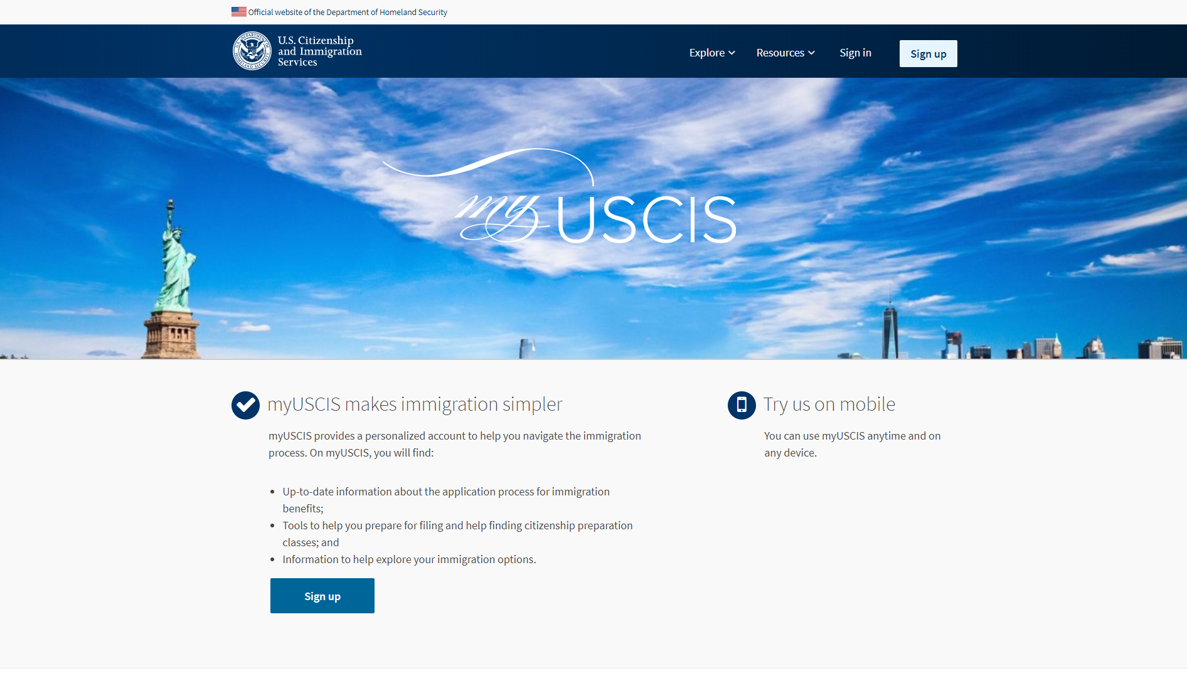
USCIS ONLINE ACCOUNT CREATION
Notes:
myUSCIS Overview - slide 3
This is the myUSCIS homepage.
myUSCIS is an online portal that serves as a one-stop shop for immigration information, various tools, and resources to help applicants and registrants navigate the immigration process.
It is accessible any time at my.uscis.gov from any mobile device or desktop computer.

Slide 4
USCIS ONLINE ACCOUNT CREATION
Notes:
USCIS Online Account Creation - slide 4
You must create a free myUSCIS account in order to complete the H-1B electronic registration process and pay the associated fee.
If you already have an account, you can access your account login directly from my.uscis.gov by clicking the “sign in” button in the top right corner. If you do not have an account, you can create one by clicking the “sign up” button in the top right corner.
For the purposes of this presentation, I am going to be a new user so that we can go through the process of creating a new online account.
I will start by clicking the “sign up” button in the top right corner. You can also click the blue “sign up” at the bottom of the page.

Slide 5
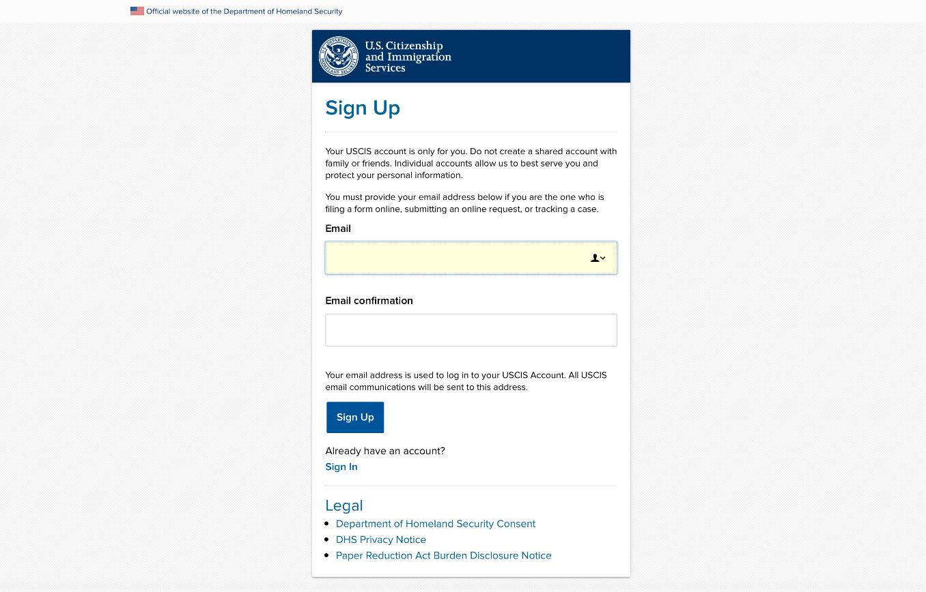
USCIS ONLINE ACCOUNT CREATION
1
1
2
Notes:
USCIS Online Account Creation – slide 5
Once I click on the “Sign Up” button, the system will prompt me to enter an email address. We suggest using a unique email address, and not one that is shared.
I will then confirm my email address and click sign up again.
When you create your account, the system will send you a notification to your email asking you to confirm your myUSCIS account request.
From your email, you will click on the link…

Slide 6
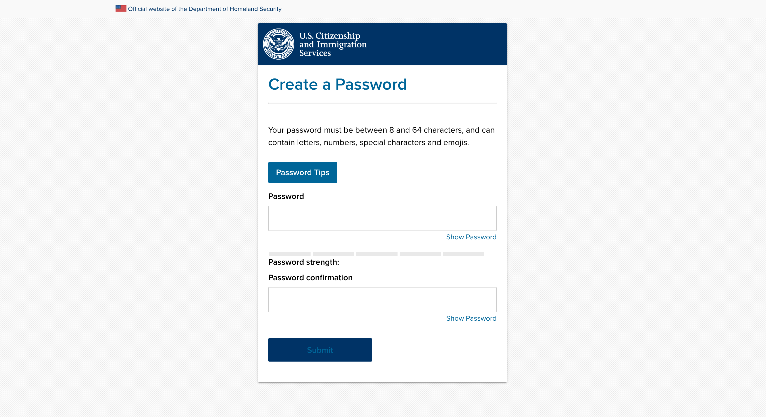
USCIS ONLINE ACCOUNT CREATION
Notes:
USCIS Online Account Creation - slide 6
The system will redirect you to the “Create a Password” page, where you will need to enter and then confirm your own password for the account. Passwords must be between 8 and 64 characters and can contain letters, numbers, special characters and emojis.

Slide 7
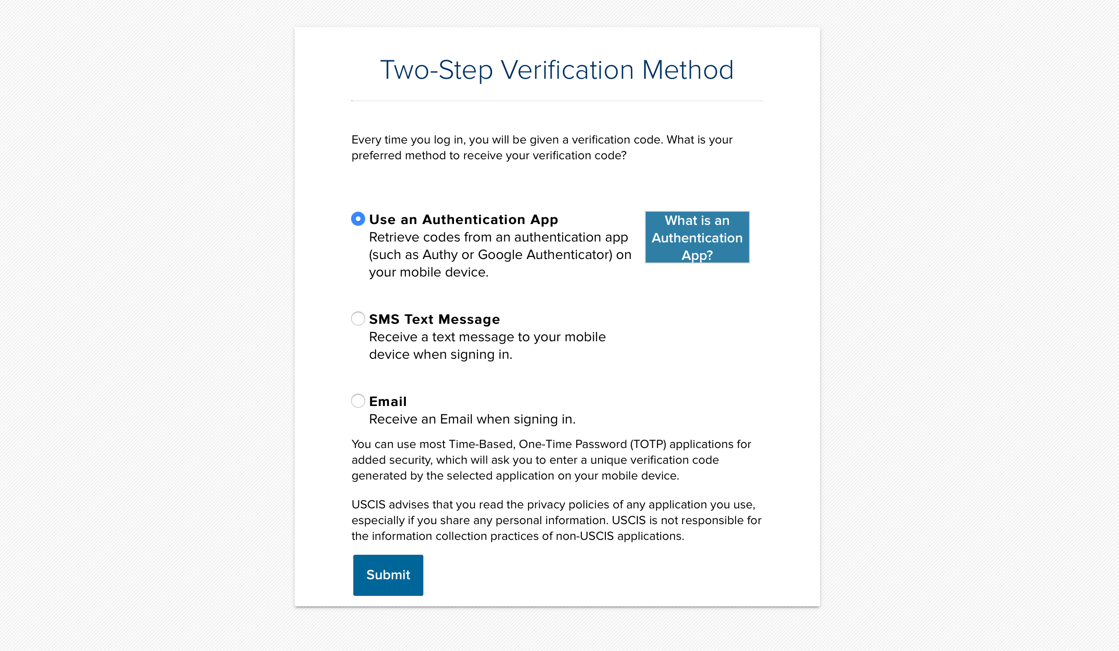
USCIS ONLINE ACCOUNT CREATION
Notes:
USCIS Online Account Creation - slide 7
The system will then take you to the Two-Step Verification Method page.
To secure your account, we use a two-step verification process for login. Every time you log in, in addition to entering your password, you will also need to enter a short verification code. Here you can select how you wish to receive that code.

Slide 8
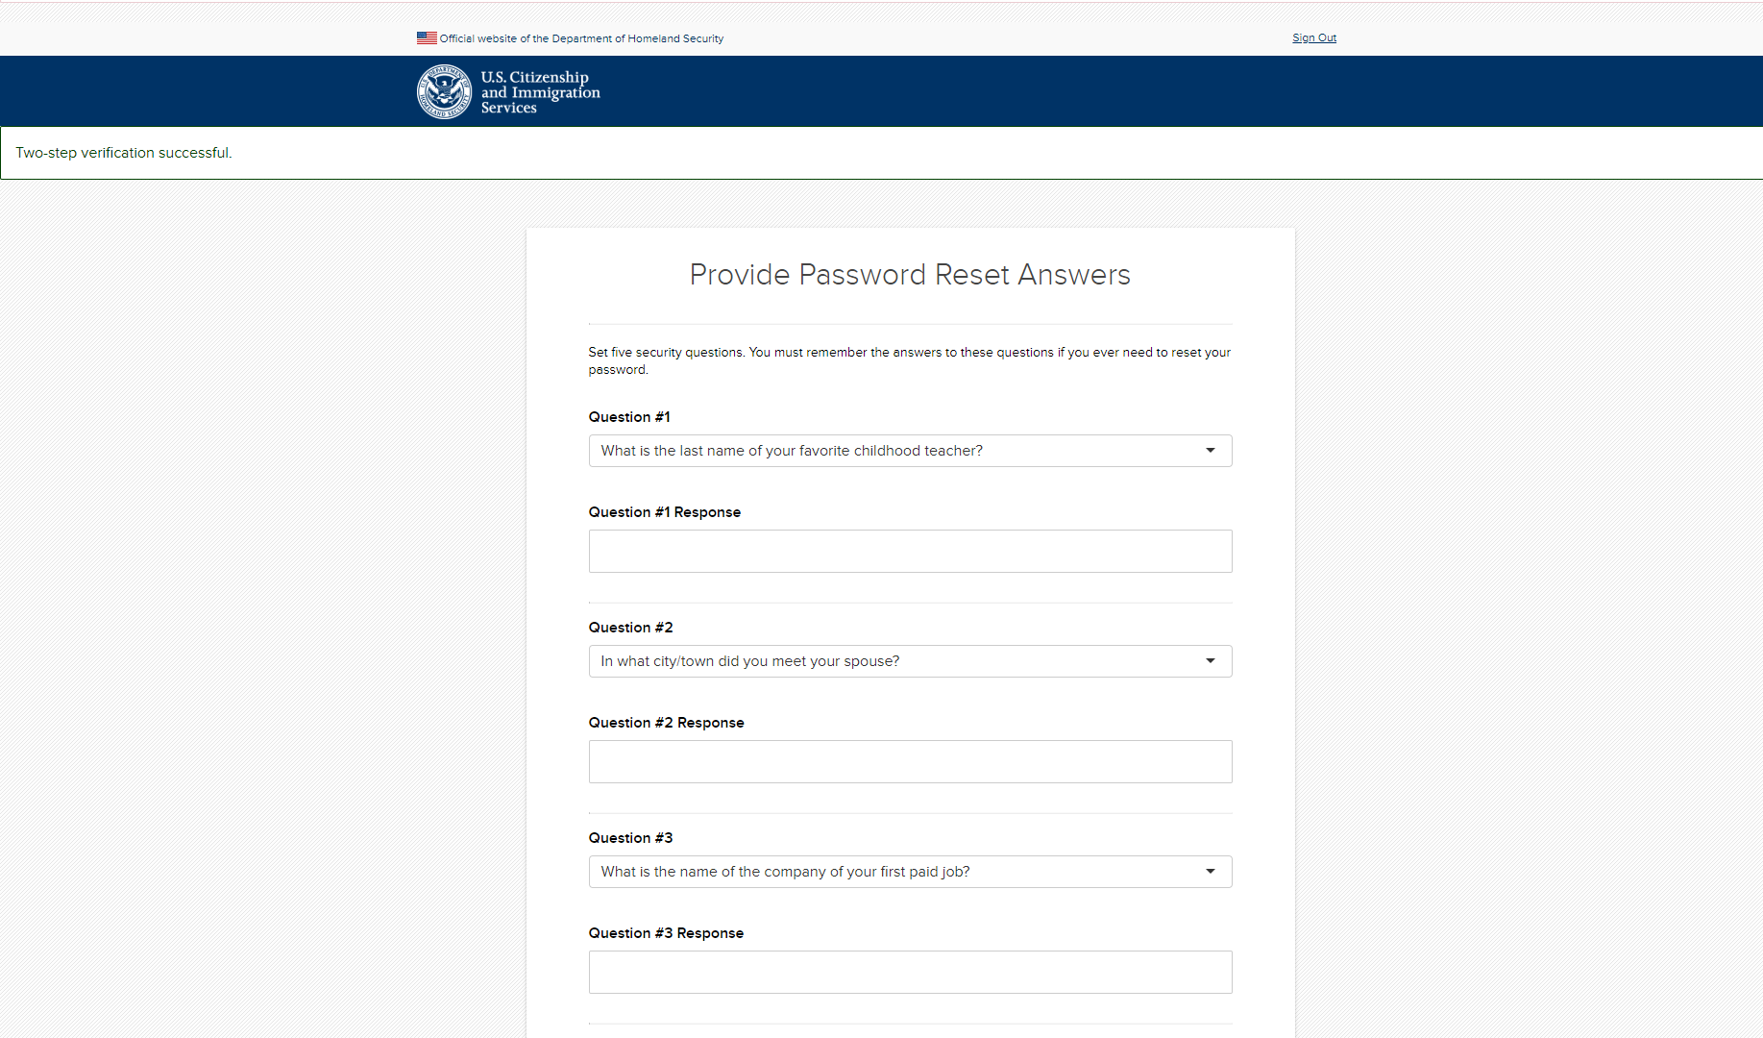
USCIS ONLINE ACCOUNT CREATION
Notes:
USCIS Online Account Creation – slide 8
The system will then ask you to provide password reset answers. You must select five security questions that will be used to determine your identity should you ever need to reset your password.

Slide 9
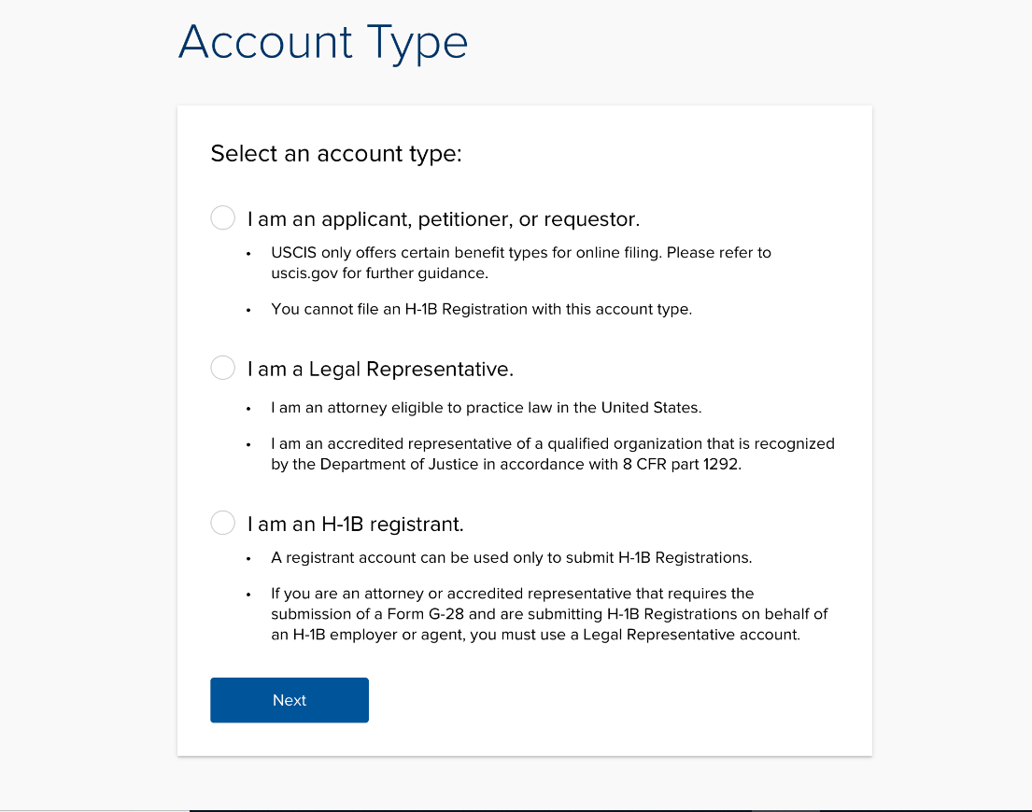
H-1B ACCOUNT TYPE
Notes:
H-1B Account Creation - slide 9
The next page that you will see is the account type page where you will choose your account type: “I am an applicant, petitioner, or requestor”; “I am a legal representative”; or “I am an H-1B registrant.”
I will select “I am an H-1B registrant” and then click Next.
A registrant is the prospective petitioning individual, company, entity, or organization submitting a registration into the selection process for a beneficiary who is a prospective H-1B nonimmigrant worker.

Slide 10
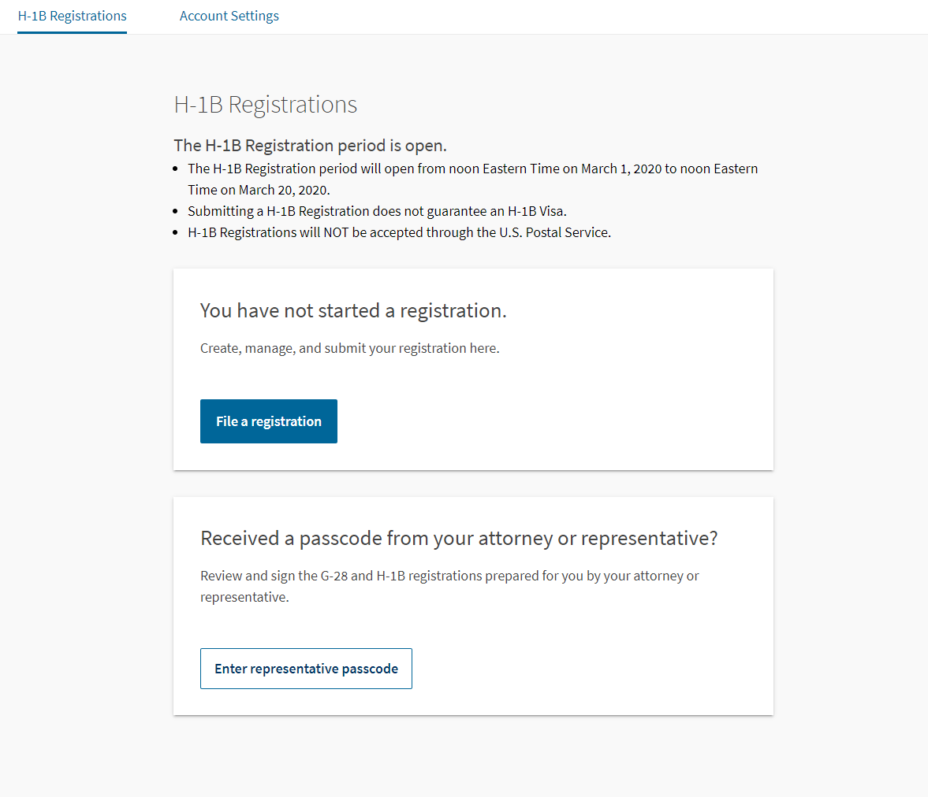
H-1B REGISTRATION
Notes:
H-1B Registration– slide 10
So now we will start the registration.
Click “File a registration,” to begin.
On this page you will have the option to enter your representative passcode, if applicable, to sign any G-28s prepared for you by your attorney or representative.

Slide 11
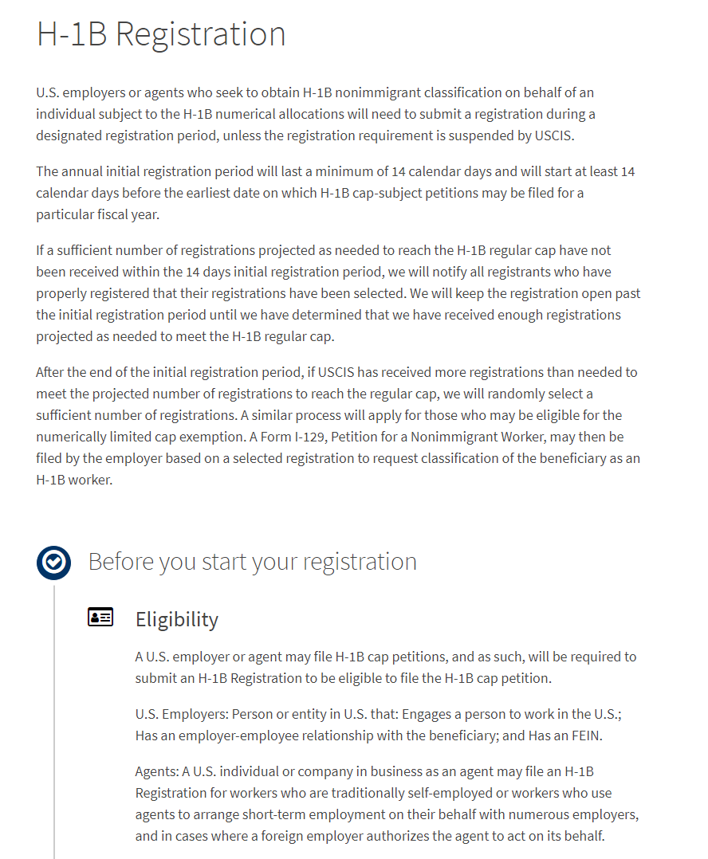
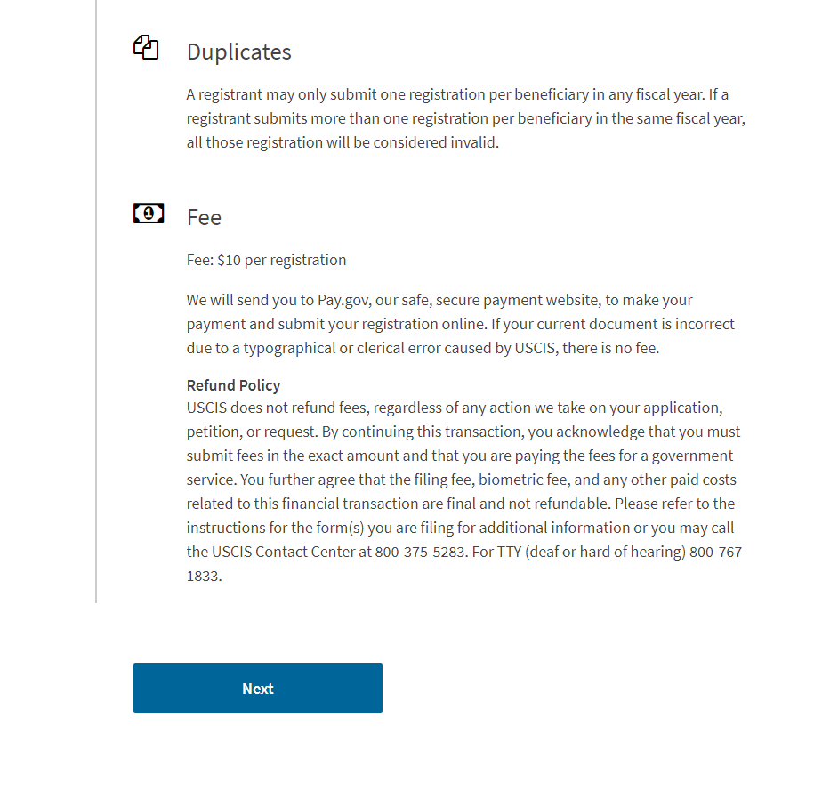
H-1B REGISTRATION
Notes:
H-1B Registration– slide 11
This is the H-1B registration overview page. It provides an overview of the H-1B registration requirement, selection process, eligibility requirements and $10 fee per registration.
The page also notifies you that you may submit only one registration per beneficiary in any fiscal year. If you submit more than one registration per beneficiary in the same fiscal year, all registrations submitted by your company or entity for this particular beneficiary will be considered invalid and deleted from the selection process.
Only this beneficiary will be deleted from the selection process. If you properly submitted other registrations for different beneficiaries, these valid registrations will remain in the system for the selection process.
You have until March 20, while the initial registration period is still open, to log into your account, review all of your H-1B registrations and delete any duplicate registrations.
You can submit registrations for up to 250 beneficiaries as part of one payment and submission. If you wish to register more than 250 beneficiaries, simply repeat this submission and payment process again.
Although you can only submit registrations for up to 250 beneficiaries at a time, there is no overall limit on the total number of registrations you can submit per employer/agent.
Click the “Next” button after you review all of the information on this page.

Slide 12
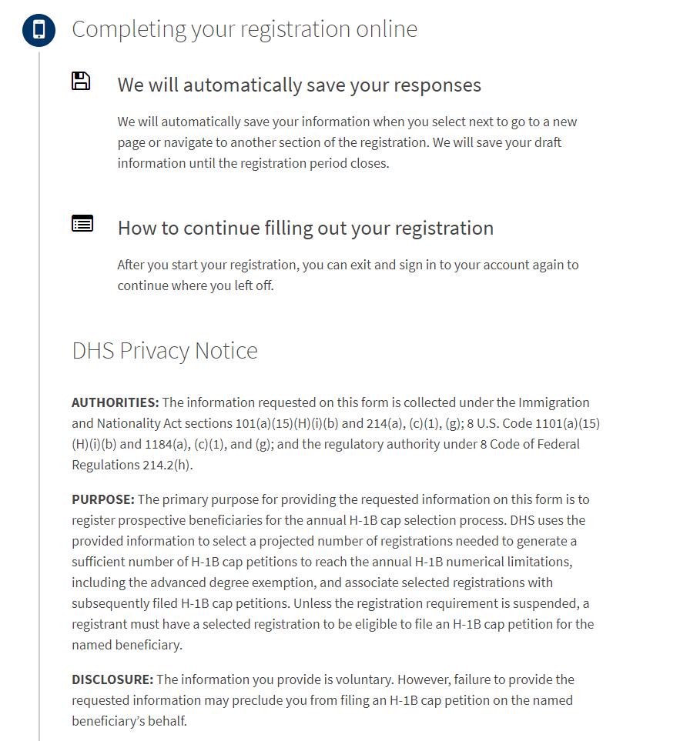
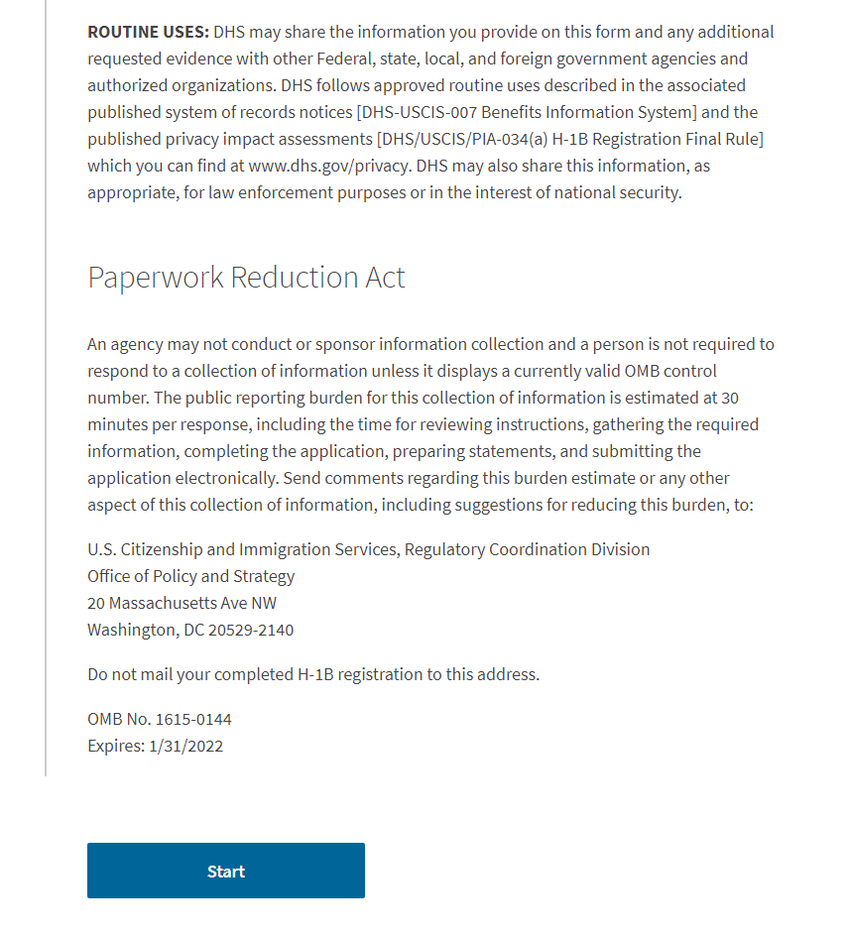
H-1B REGISTRATION
Notes:
H-1B Registration– slide 12
The next H-1B overview page provides you with instructions on how to continue filling out your H-1B registration, should you need to sign out of your account and complete the draft at a later time.
The page also provides a copy of the DHS Privacy Notice and an overview of the Paperwork Reduction Act.
Click “Start” to proceed.

Slide 13
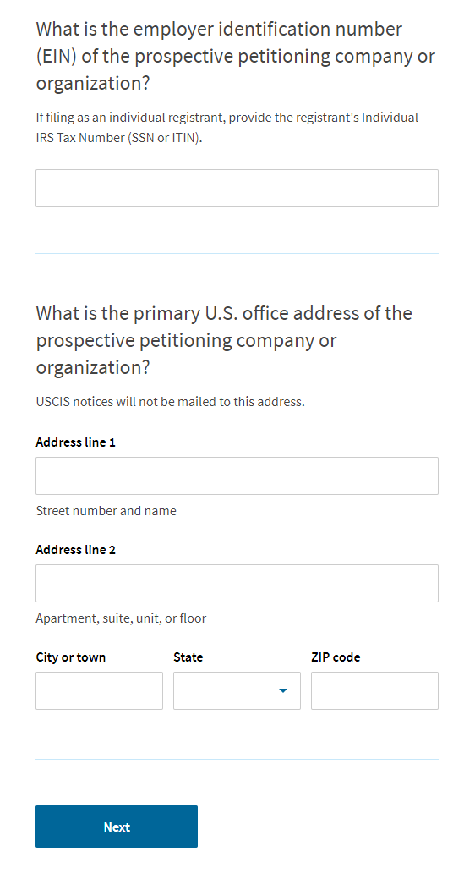
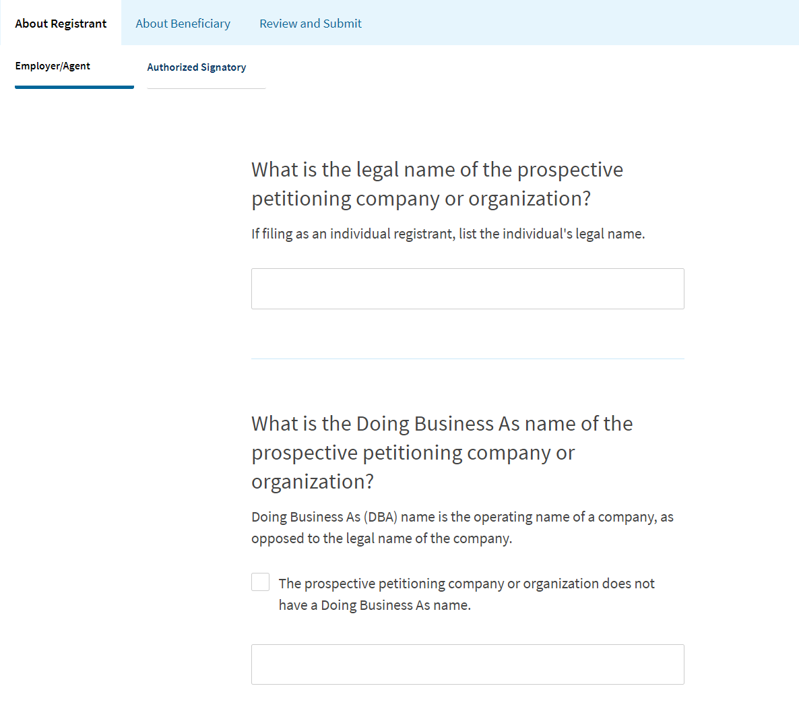
REGISTRANT INFORMATION
Notes:
Registrant Information – slide 13
“About Registrant” is the first tab you will see when you start to submit the registration.
You will begin by entering information for you, the prospective petitioner, that is registering on behalf of a prospective beneficiary.
Enter the legal name and the Doing Business As name of your company or organization.
If you do not have a Doing Business As name, select the box to indicate this.

Slide 14
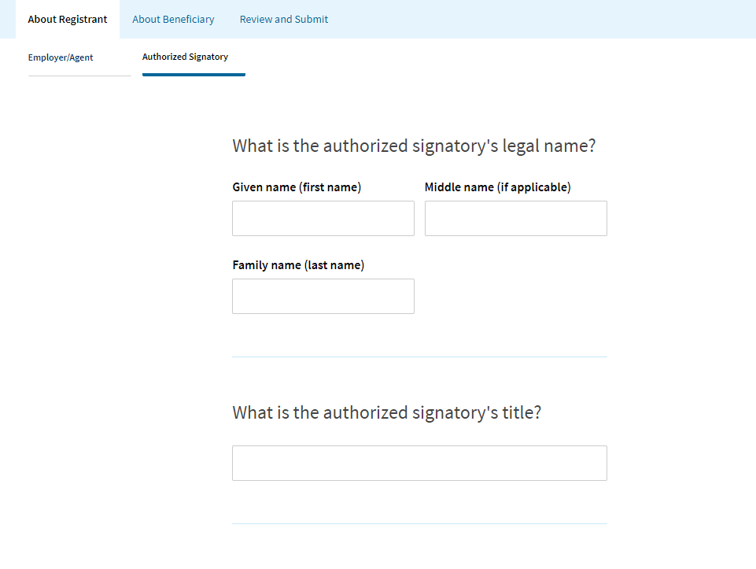
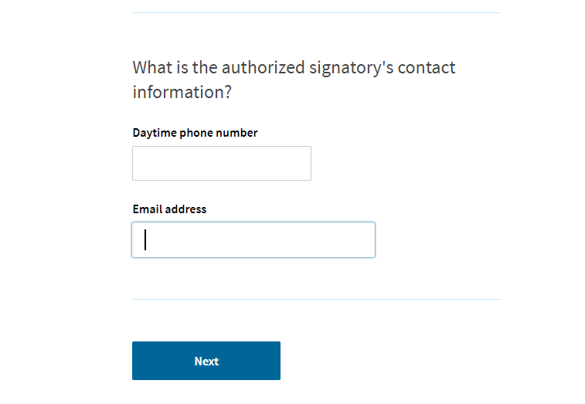
SIGNATORY INFORMATION
Notes:
Signatory Information – slide 14
Next, you will enter information for the Authorized Signatory.
The Authorized Signatory is a person at your company or organization who is authorized to sign legal documents on behalf of the company or organization. Enter the first, last and middle name, if applicable, title, phone number and email address for the Authorized Signatory.
Then click “Next.”

Slide 15
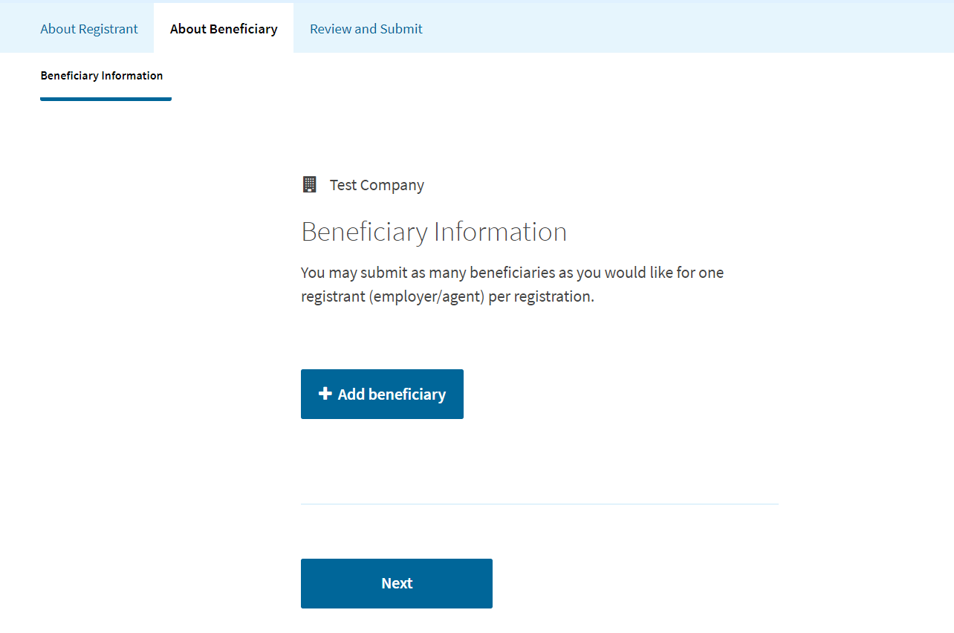
BENEFICIARY INFORMATION
Notes:
Beneficiary Information – slide 15
The next tab you will see is “About Beneficiary.”
Click “Add beneficiary” to begin entering information for the beneficiary. This is the person that your company or organization is trying to employ.

Slide 16
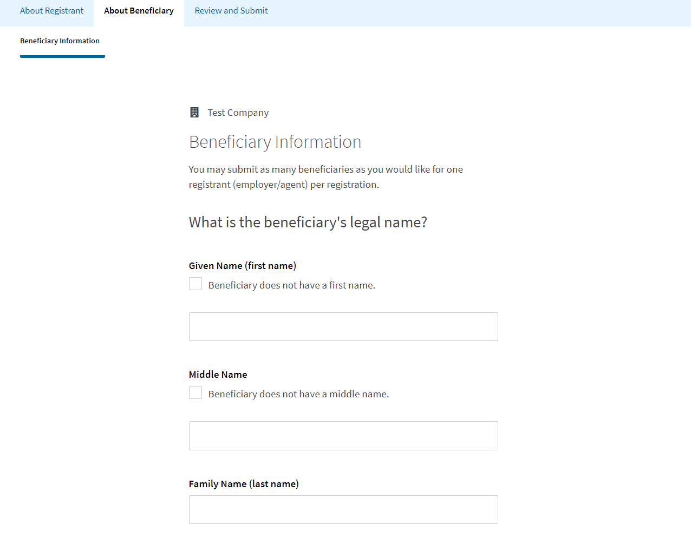
BENEFICIARY INFORMATION
Notes:
Beneficiary Information – slide 16
For the next pages, you will enter the beneficiary’s information.
On this page, you will enter the beneficiary’s first name, middle name and last name. Remember to check the box if the beneficiary does not have a first name or middle name.

Slide 17
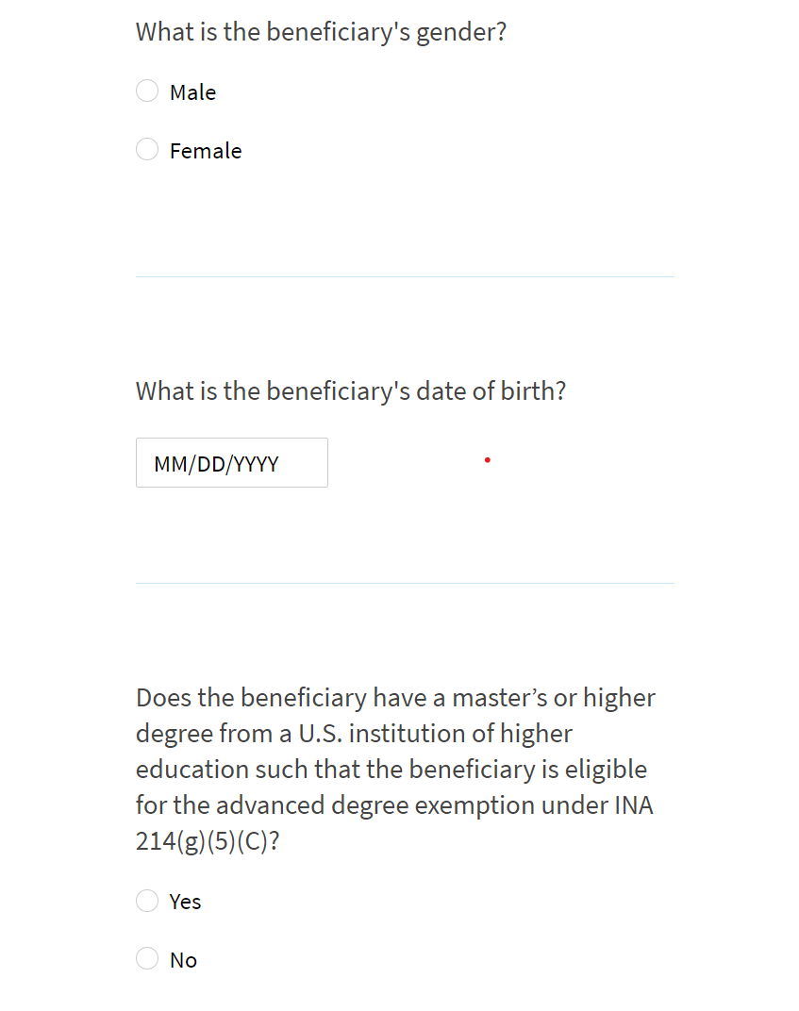
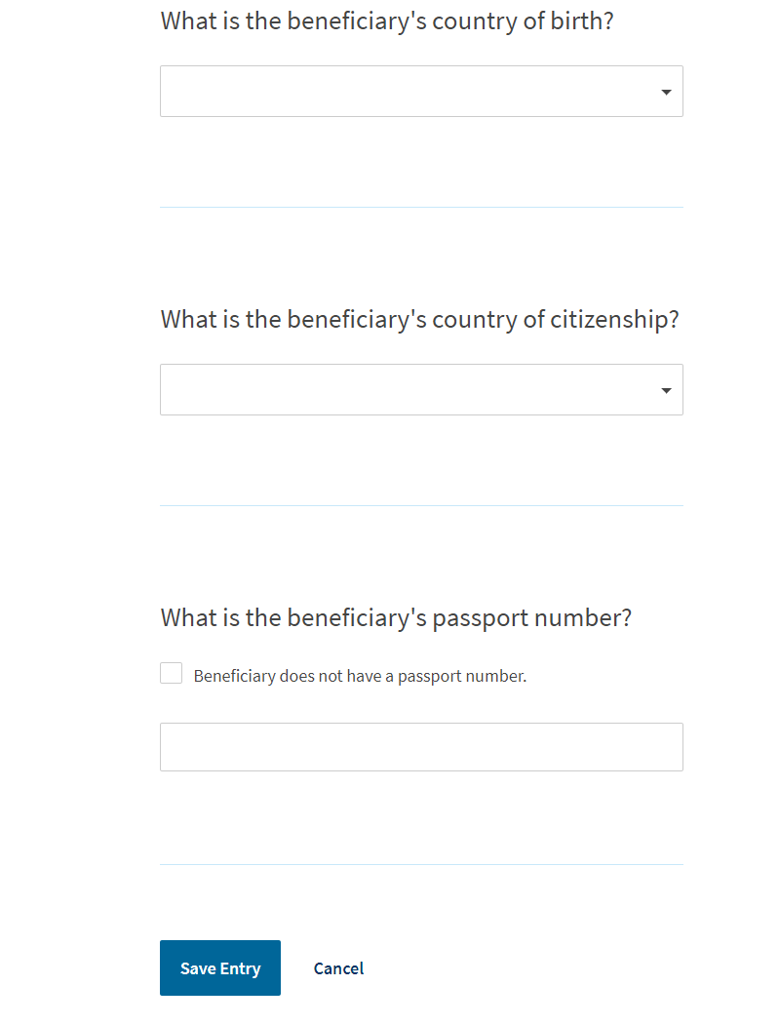
BENEFICIARY INFORMATION
Notes:
Beneficiary Information – slide 17
On this page, you will enter the beneficiary’s gender, date of birth, and confirm if they have a qualifying master’s or higher degree from an eligible U.S. institution of higher education that would make them eligible for the advanced degree exemption (master’s cap). You will also enter the beneficiary’s country of birth, country of citizenship or nationality and passport number.
Then click the blue “Save Entry” button.

Slide 18
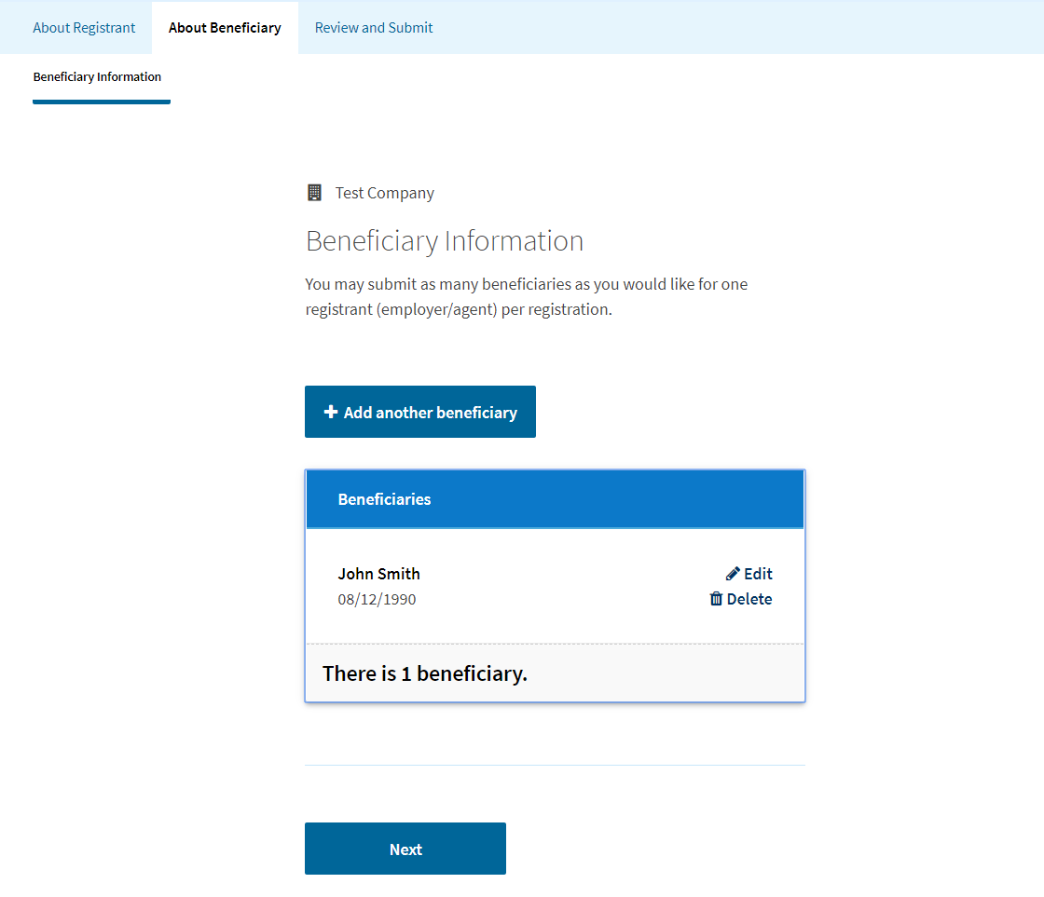
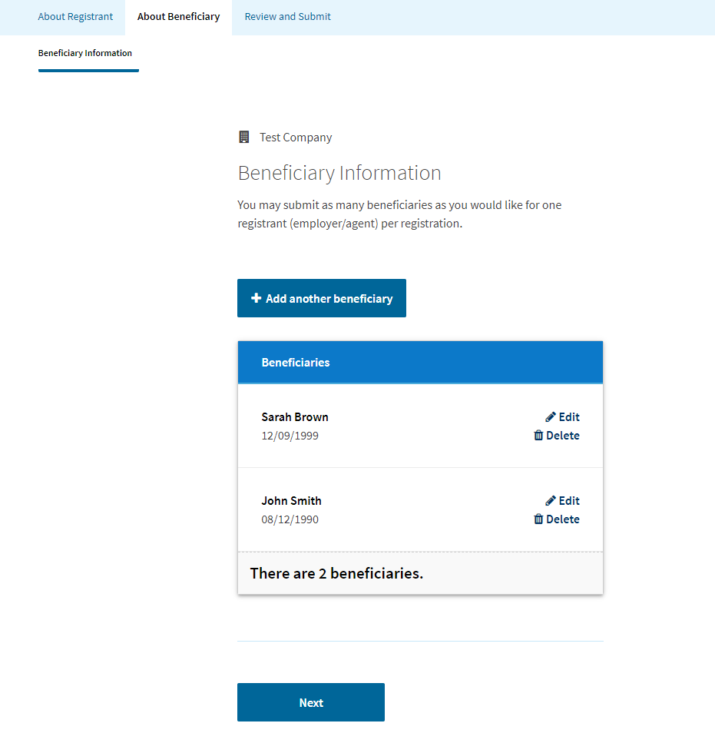
BENEFICIARY INFORMATION
Notes:
Beneficiary Information – slide 18
You will then have the option to enter additional beneficiaries.
Click “Add another beneficiary.”
You can submit registrations for up to 250 beneficiaries as part of one payment and submission. If you wish to register more than 250 beneficiaries, simply repeat this submission and payment process again.
Although you can only submit registrations for up to 250 beneficiaries at a time, there is no overall limit on the total number of registrations you can submit per company.
All of the beneficiaries that you entered will appear on this page in a table.
If you want to edit any of the beneficiaries that you entered, you can press edit and go in to edit any of the fields in this draft. To delete them, click the delete button.
After you enter all of your prospective beneficiaries, select “Next” to continue.

Slide 19
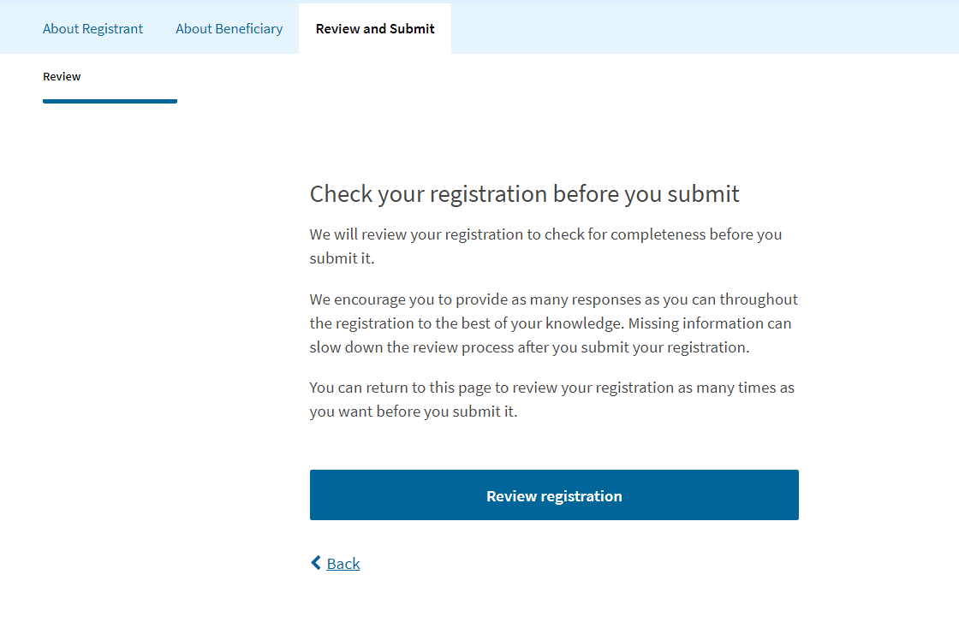
REVIEW AND SUBMIT
Notes:
Review and Submit – slide 19
Now you will review the H-1B registration(s) to ensure that all of your responses are accurate to the best of your knowledge. You can return to this page as many times as you want to review your registration(s) before you submit it.
Click “Review Registration.”

Slide 20
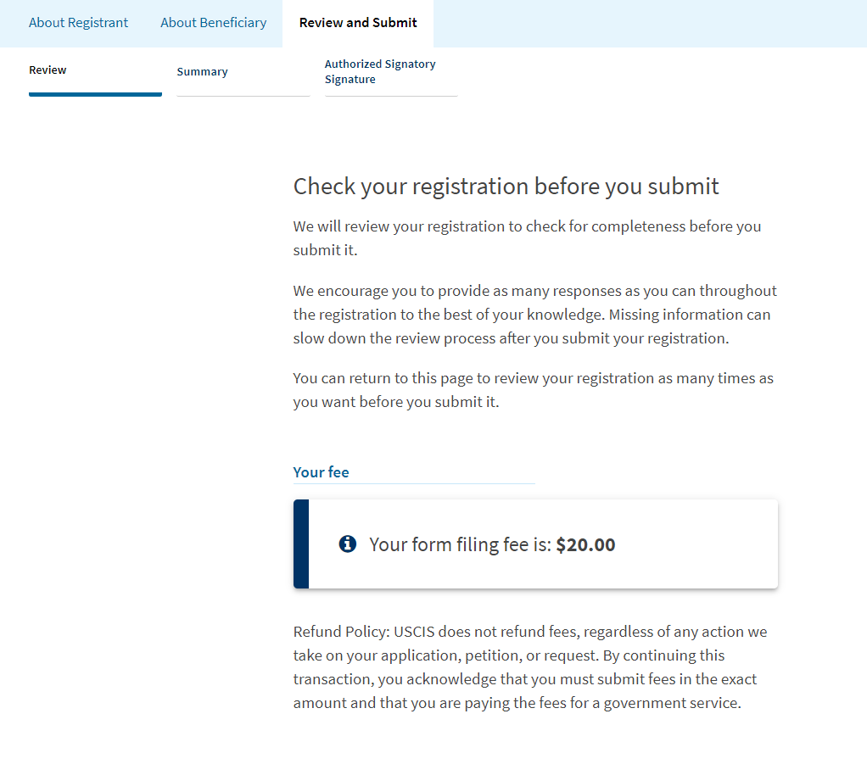
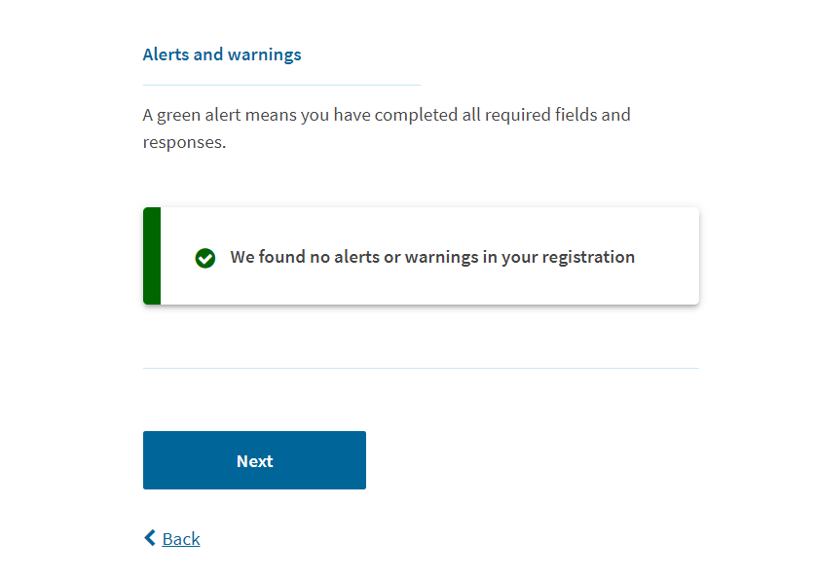
REVIEW AND SUBMIT
Notes:
Review and Submit – slide 20
This next page will display the registration fee. Here the registration fee is $20 dollars because I entered two beneficiaries and there is a $10 fee for the registration submitted on behalf of each beneficiary.
This page also notifies me that I have no alerts or warnings, because I completed all of the required information.
If you did not complete all of the information, this page would display a red warning message with a button to direct you back to the corresponding page to complete that information.
The system checks for completeness, not accuracy. Please review all information entered, for accuracy, before summiting.
Click “Next” at the bottom of the page to proceed.

Slide 21
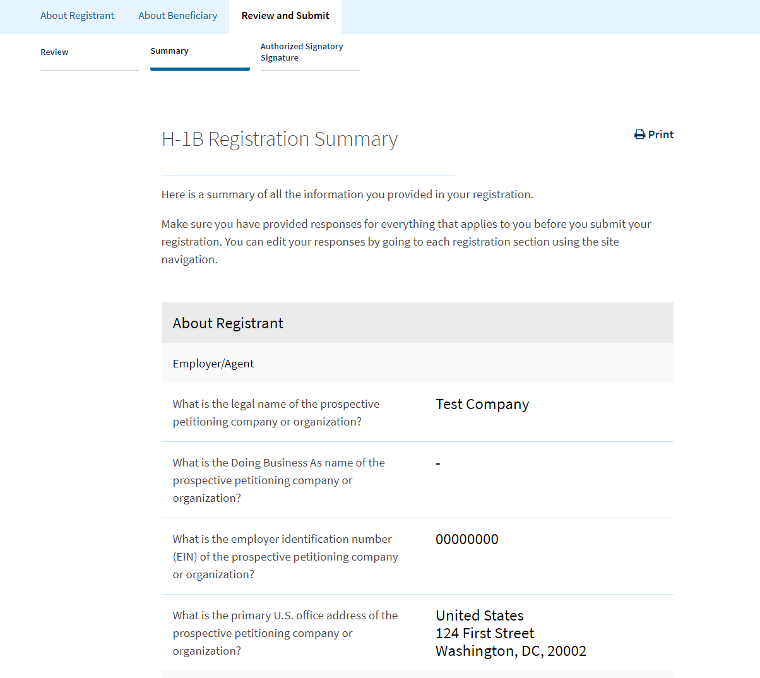
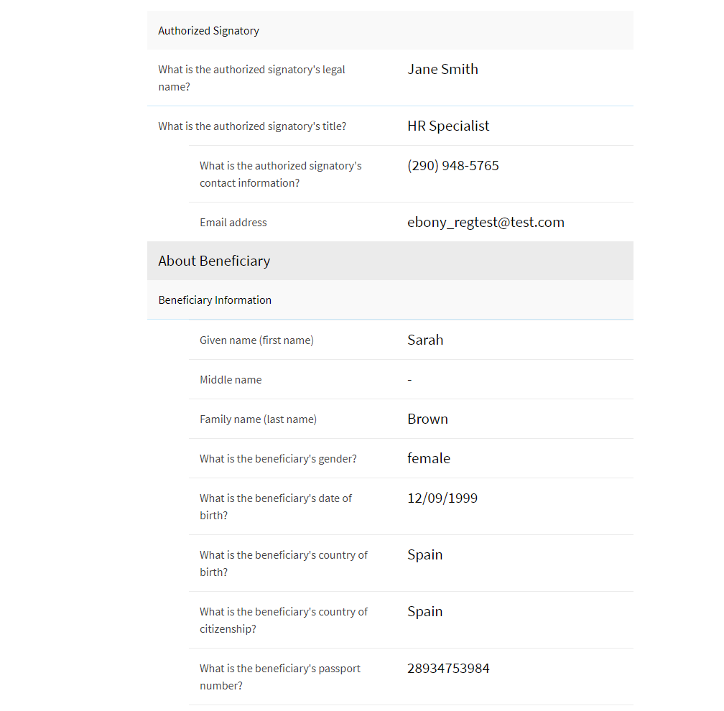
REVIEW AND SUBMIT
Notes:
Review and Submit – slide 21
This sections provides a review summary of the entire registration, beginning with the About Registrant (Employer/Agent) information.
The summary continues with a review of each beneficiary that you entered under this submission. You can scroll down to see each entry.
You can also go to your homepage and export the list of beneficiaries as a csv file. We will walk you through how to do that later in the presentation.

Slide 22
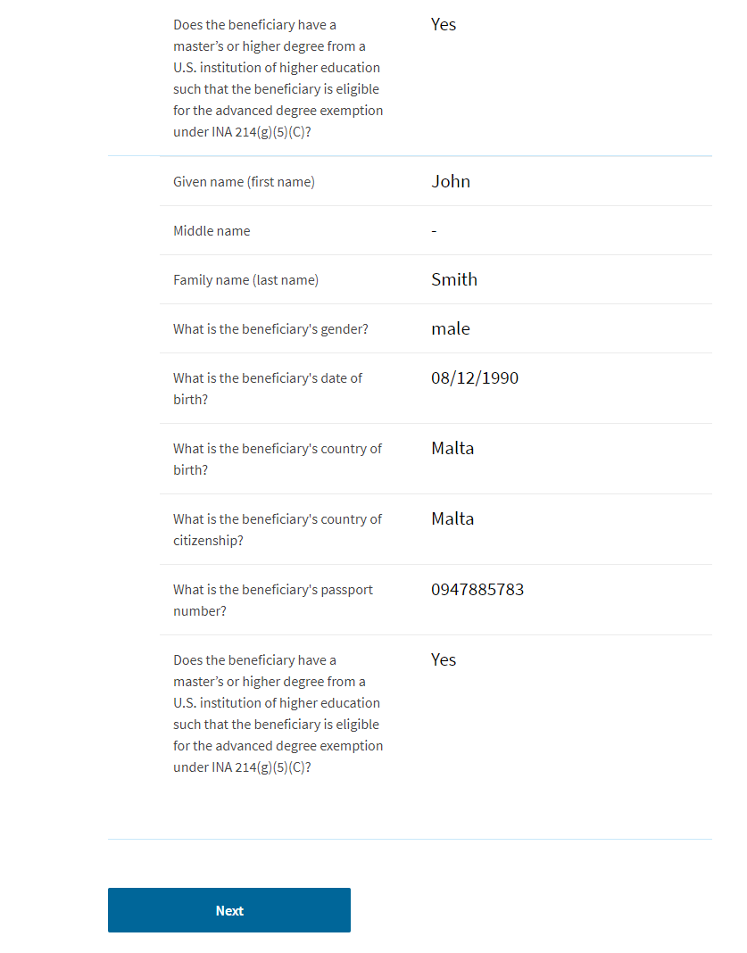
REVIEW AND SUBMIT
Notes:
Review and Submit – slide 22
After you review the H-1B registration summary, click “Next” to continue.

Slide 23
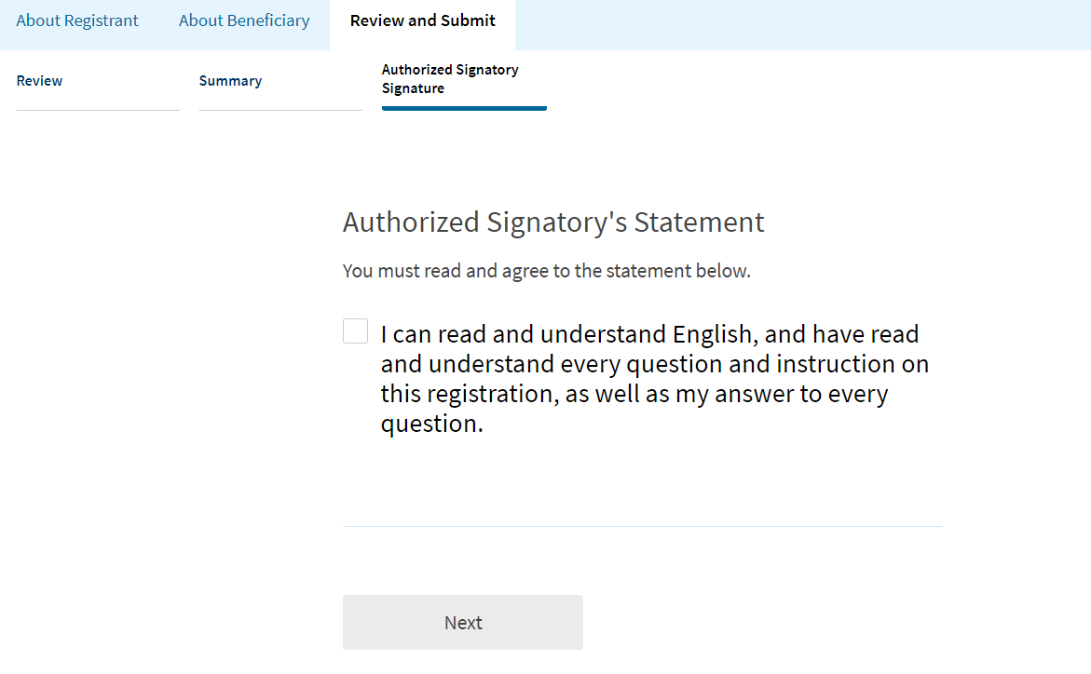
REVIEW AND SUBMIT
Notes:
Review and Submit– slide 23
Here, you will review the Authorized Signatory Statement and confirm that you understand all of the questions and instructions.
Click “Next” to continue.

Slide 24
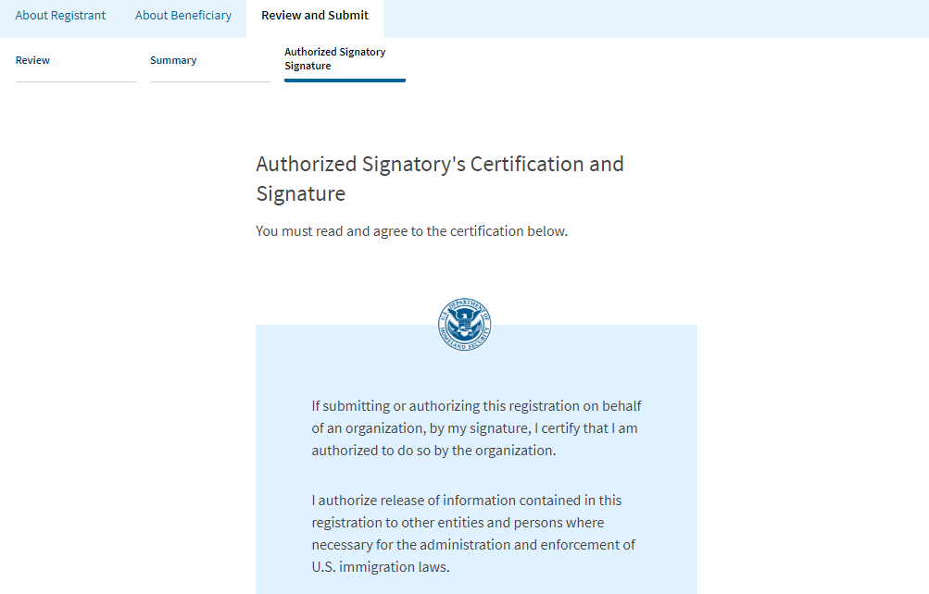
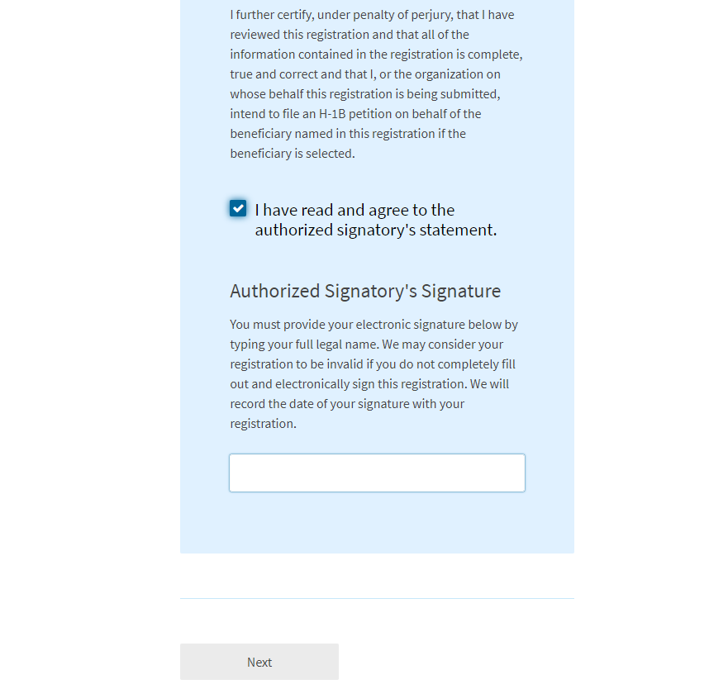
REVIEW AND SUBMIT
Notes:
Review and Submit – slide 24
Next, is the Authorized Signatory’s certification and signature page.
You will be asked to verify that all of the information entered for the company and beneficiaries is complete, true and correct.
Once you click, “I have read and agreed to the authorized signatory’s statement,” a signature box will pop up.
Enter your name and press “Next.”

Slide 25
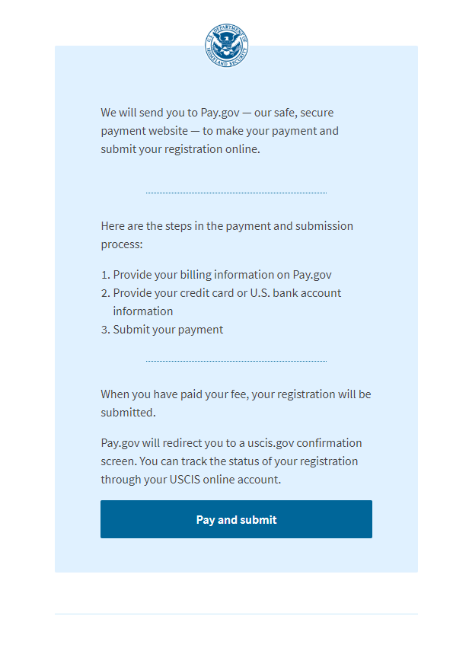
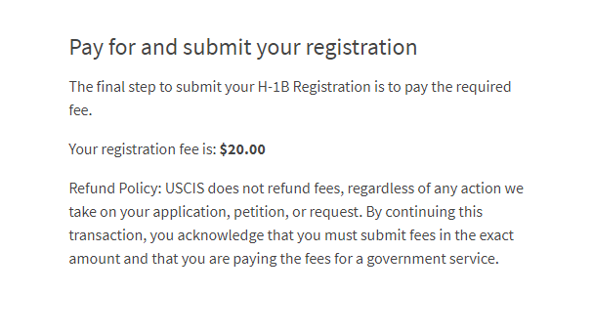
PAYMENT
Notes:
Payment– slide 25
The next screen will prompt you to pay for and submit your registrations.
Click “Pay and submit”

Slide 26
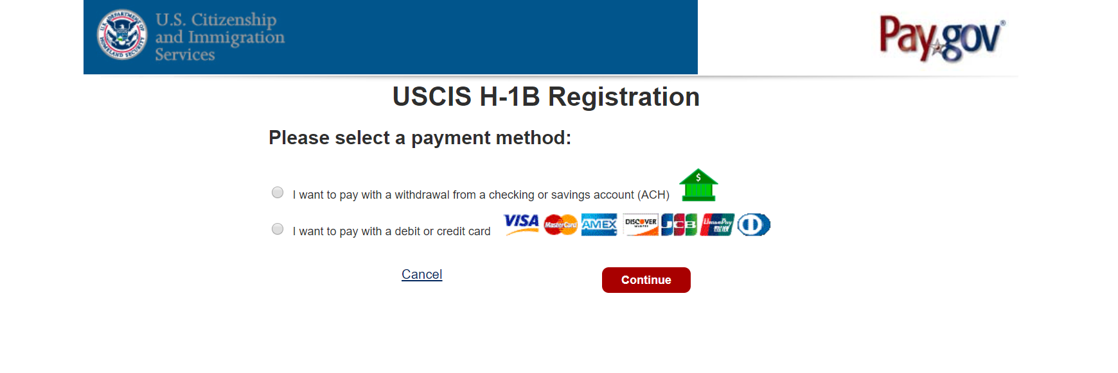
PAYMENT
Notes:
Payment– slide 26
You will be routed to a different website, pay.gov, where you will pay the H-1B registration fee.
Pay.gov is a government website separate from the USCIS website. If pay.gov experiences issues and is not able to accept your payment, you will see an error message.
You would log back into your myUSCIS account and go through these steps to pay at a different time.
The myUSCIS system will save your registration until you are able to process the payment. To be considered for the initial registration period and associated selection process, payments and the H-1B registrations must be submitted before the end of the initial registration period on March 20.
On the pay.gov website, Select your payment method and click “Continue.”
For the purposes of this presentation, we will choose credit card payment.

Slide 27
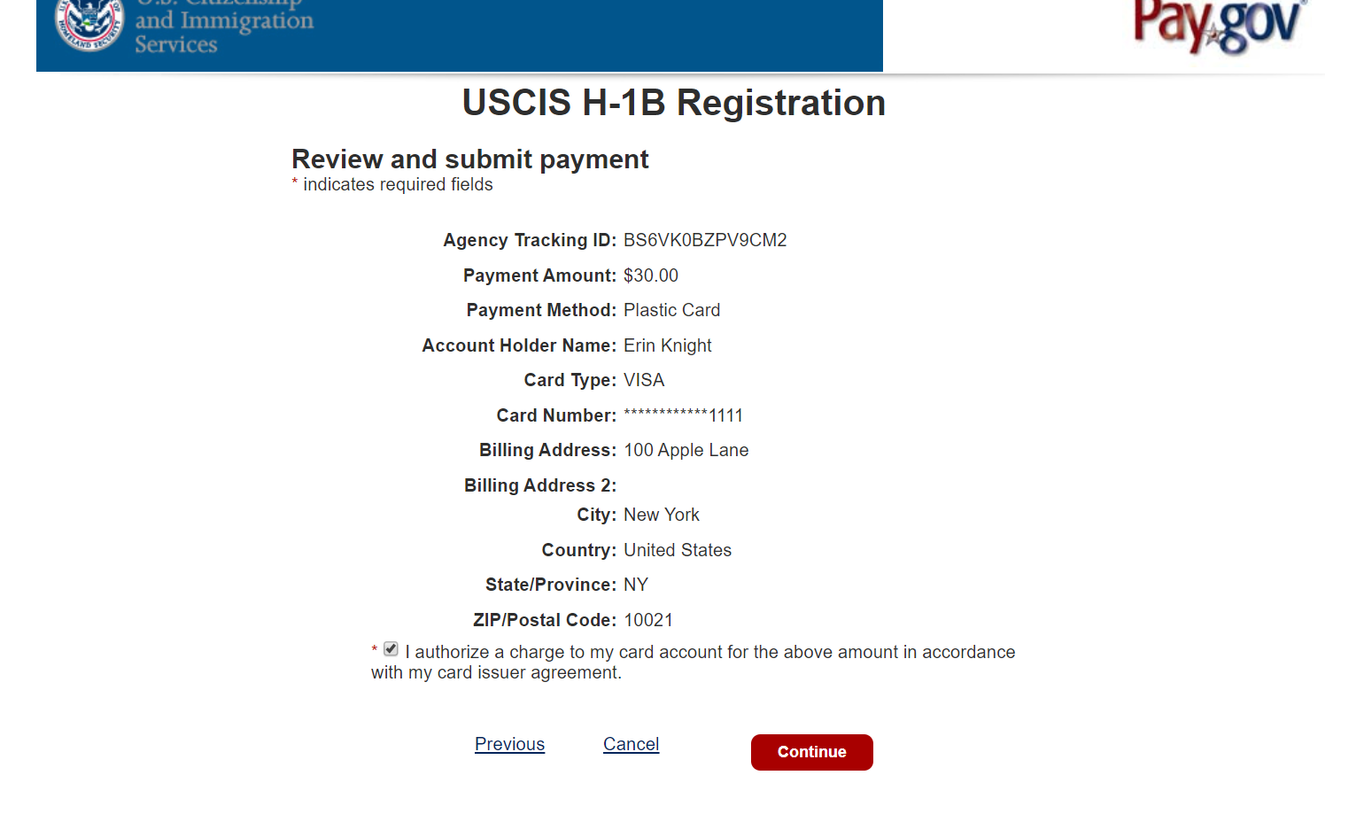
PAYMENT
Notes:
Payment– slide 27
You will enter all of your billing information and click “continue.” Then you will select the button to certify that you authorize this transaction on your method of payment.
Click “continue” again to finish the payment.

Slide 28
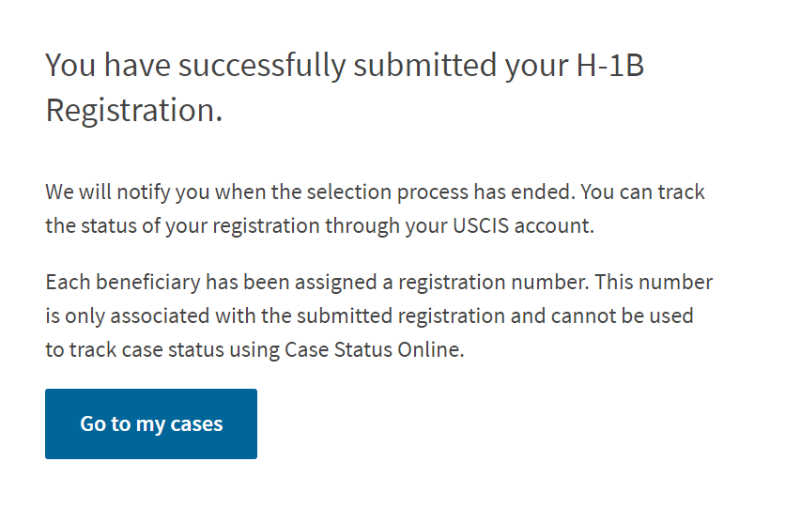
COMPLETE REGISTRATION
Notes:
Complete Registration– slide 28
The next page confirms that you have successfully submitted your H-1B registration and provides information on how to track your status.
Click “Go to my cases” to return to your dashboard.

Slide 29
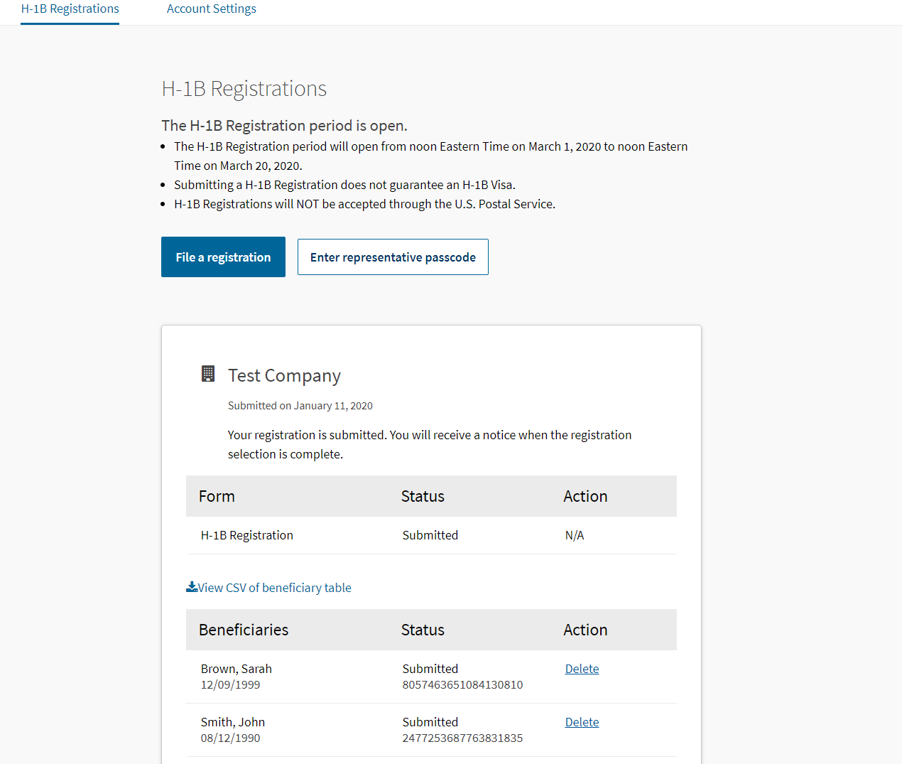
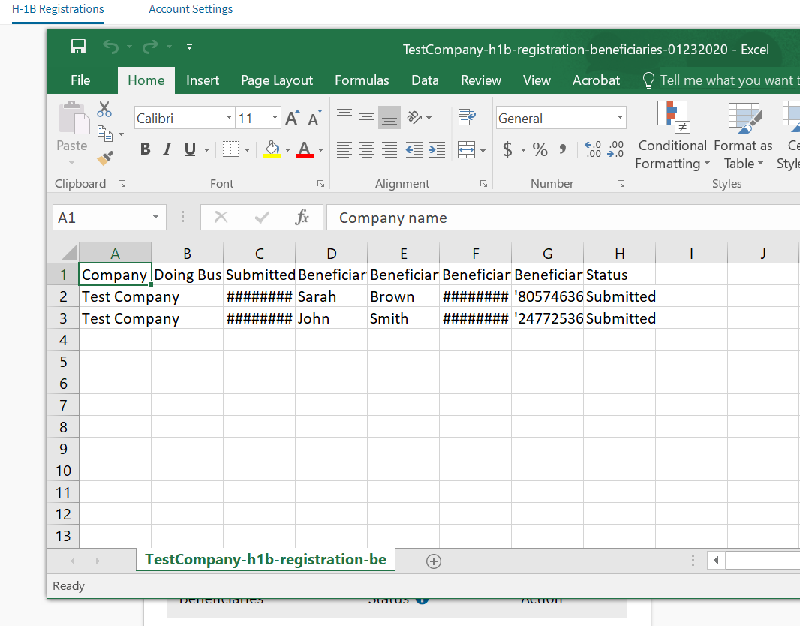
COMPLETE REGISTRATION
Notes:
Complete Registration – slide 29
From your homepage, click “View all cases,’’ to see the current status of all of your H-1B registrations.
You will see that the status for each registration/beneficiary says “submitted.”
Each beneficiary has also been assigned a confirmation number. This is the unique 19-digit identifier assigned to each registration for each beneficiary in a submission.
This number is only associated with the H-1B registration and cannot be used to track case status using Case Status Online.
From this homepage you can also click “View csv of beneficiary table,” to download the information.

Slide 30
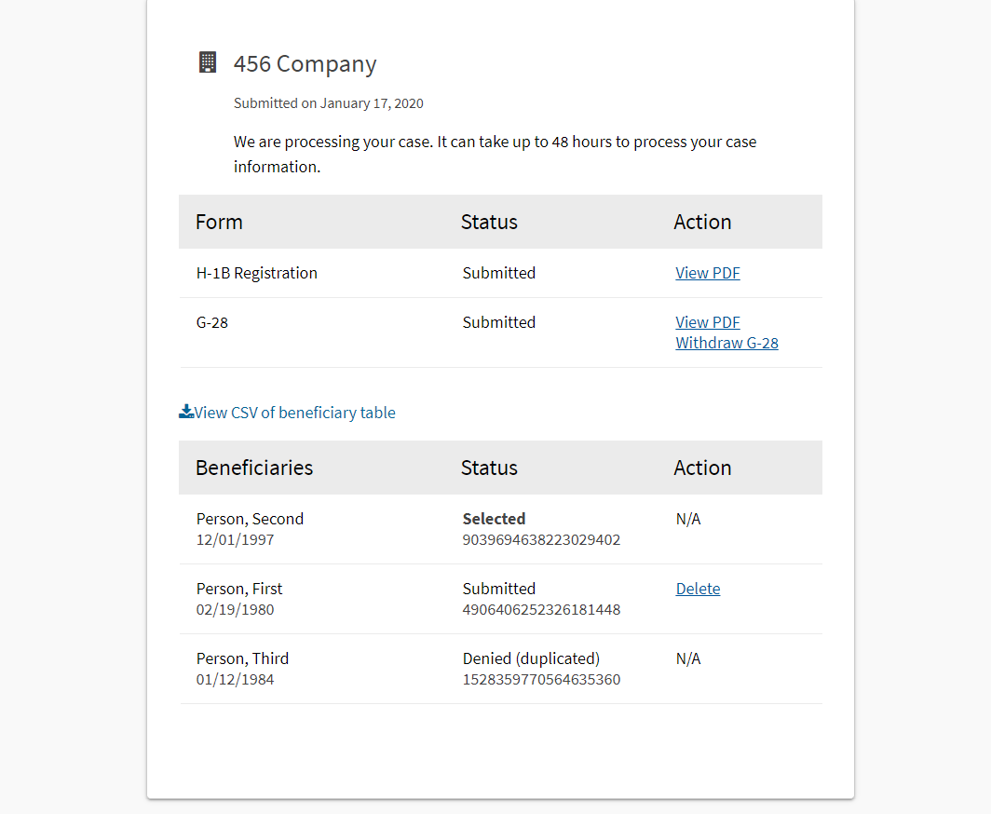
H-1B REGISTRATION STATUS
Notes:
H-1B Registration Status – slide 30
This screen shows a sample of status updates from the selection process.
After the initial registration period closes, USCIS will conduct the initial selection process.
USCIS will notify you, through the method you chose, when there is activity on your account. You can also track the status of your registration through your USCIS account.
After the initial selection process, registrations will be identified as having one of the three following statuses:
“Submitted,” “Selected,” and “Denied (Duplicated).”
“Submitted”
A registration status may continue to show “Submitted” after the initial selection process has been completed. "Submitted" registrations will remain in consideration for selection until the end of the fiscal year, at which point all registration statuses will be Selected, Not Selected, or Denied.
Selected: means that you have been selected to file an H-1B cap-subject petition.
H-1B cap-subject petitioners, including those eligible for the advanced degree exemption, must have a “Selected” registration notification in order to be eligible to properly file an H-1B cap-subject petition for FY 2021.
Petitioners with selected registrations will be eligible to file an H-1B cap-subject petition only for the beneficiaries named in the selected registrations, beginning April 1, 2020.
Petitioners with selected registrations will need to file within the 90-day period, as indicated on the selection notice.
Selection does not guarantee H-1B approval. You are still required to file a paper Form I-129 with evidence that establishes eligibility and pay the required fee.
Petitioners should print and submit a copy of their selection notifications with their petitions.
“Denied (Duplicated)”
Means that more than one registration was filed on the beneficiary’s behalf by the same registrant. All registrations filed by the registrant on behalf of this beneficiary are invalid.
As a reminder, you can log into your account to review your registrations and delete duplicates, up until the point that the registration process closes on March 20. After this, remaining duplicate registrations will be considered invalid and the status will indicate “Denied.”
At the end of the fiscal year, any registrations that were not selected as part of any selection process will be updated to “Not Selected”.
“Not Selected” means not selected for this fiscal year.

Slide 31
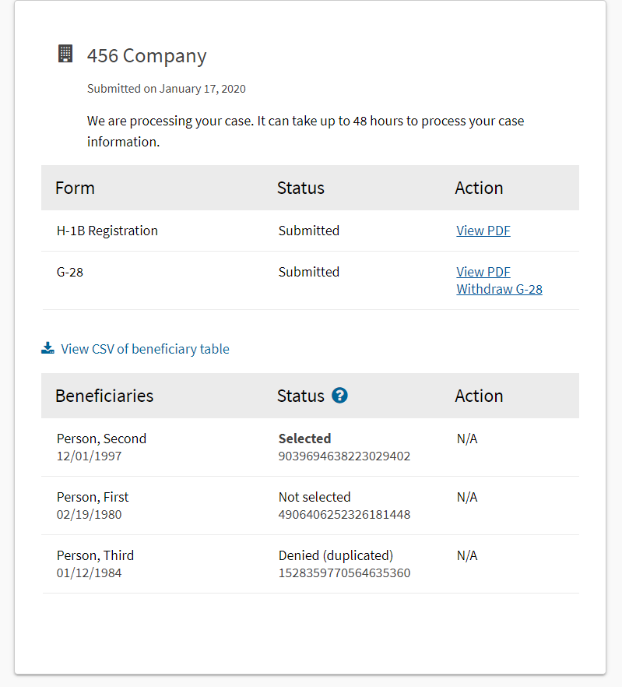
H-1B REGISTRATION STATUS
Notes:
H-1B Registration Status – slide 31
You will be able to log into your USCIS account to see the status updates.
Again, “Submitted” registrations will remain in the system, and available for possible selection, until the end of the fiscal year. So, the “Not Selected” notification will not show for any registration until the end of the fiscal year.

Slide 32
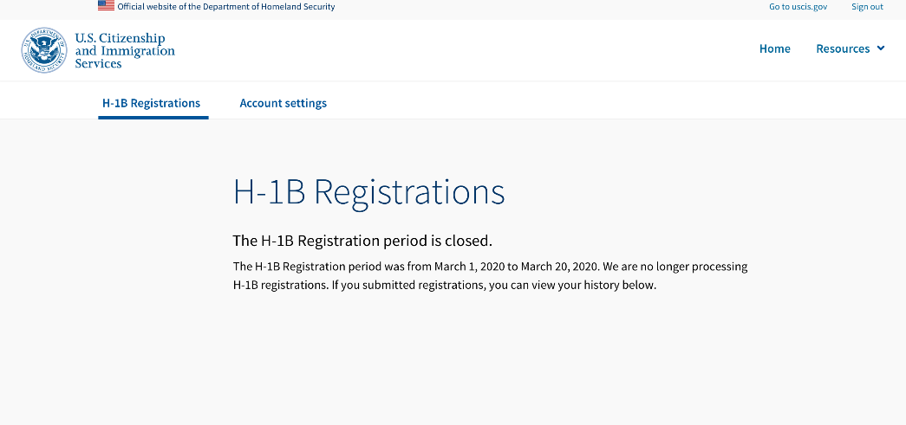
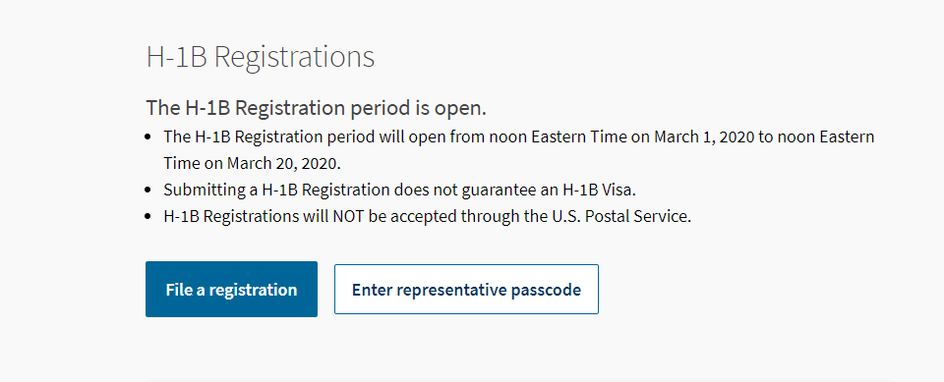
REMINDERS
Notes:
Reminders – slide 32
As a final reminder, you will only be able to register while the H-1B registration period is open from noon Eastern on March 1 to noon Eastern on March 20.
The alert at the top of the homepage will indicate when the registration period is open.
If the initial registration period is open, this message will display.
All valid registrations received during the initial registration period will be included in the initial selection process regardless of whether they were received on March 1 or March 20.
It does not matter if you enter one registration or 500 registrations. Each valid, individual registration received between March 1 and March 20 will be entered into the selection process, regardless of the day or amount entered.
If the registration period is closed, you will no longer be able to select "H-1B Registration" on the Start a Form page. You will see an alert that explains the registration period is closed.

Slide 33
CONTACT INFORMATION AND RESOURCES
Helpful links and resources:
Account sign up/login page: my.uscis.gov/account
Technical support and password resets: https://my.uscis.gov/account/needhelp
USCIS Contact Center: 1-800-375-5283
Federal Register Notice: Registration Requirement for Petitioners Seeking To File H-1B Petitions on Behalf of Cap-Subject Aliens
Uscis.gov/H-1B
Notes:
Here are some helpful resources and links.
You can log into your myUSCIS account at any time to view status updates.
For technical support and password resets visit the myUSCIS account help page.
If you need to review the steps on how to create an online account, sign into your account, or complete an H-1B registration with USCIS, you can watch helpful videos available on uscis.gov.
You can also call the USCIS customer contact center and our Interactive Voice Response system will provide you with the latest updates on the H-1B electronic registration and selection process.
For more information on the H-1B electronic registration process and implementation, you can review the Federal Register Notice or visit the H-1B page on uscis.gov.

Slide 34
Any questions?
Thank you!
Notes:
We are very excited about our online services, but there is more work to do. We are continuing to strive to improve these tools and resources every day and your feedback is an invaluable part of that process. We encourage you to please send feedback to us at public.engagement@uscis.dhs.gov.

Slide 35
DISCLAIMER
This training module is intended solely as informational. It is not intended to, does not, and may not be relied upon to create or confer any right(s) or benefits(s), substantive or procedural, enforceable at law by any individual or other party in benefit applications before USCIS, in removal proceedings, in litigation with the United States, or in any other form or manner. This training module does not have the force of law, or of a DHS directive.

